Slide 1

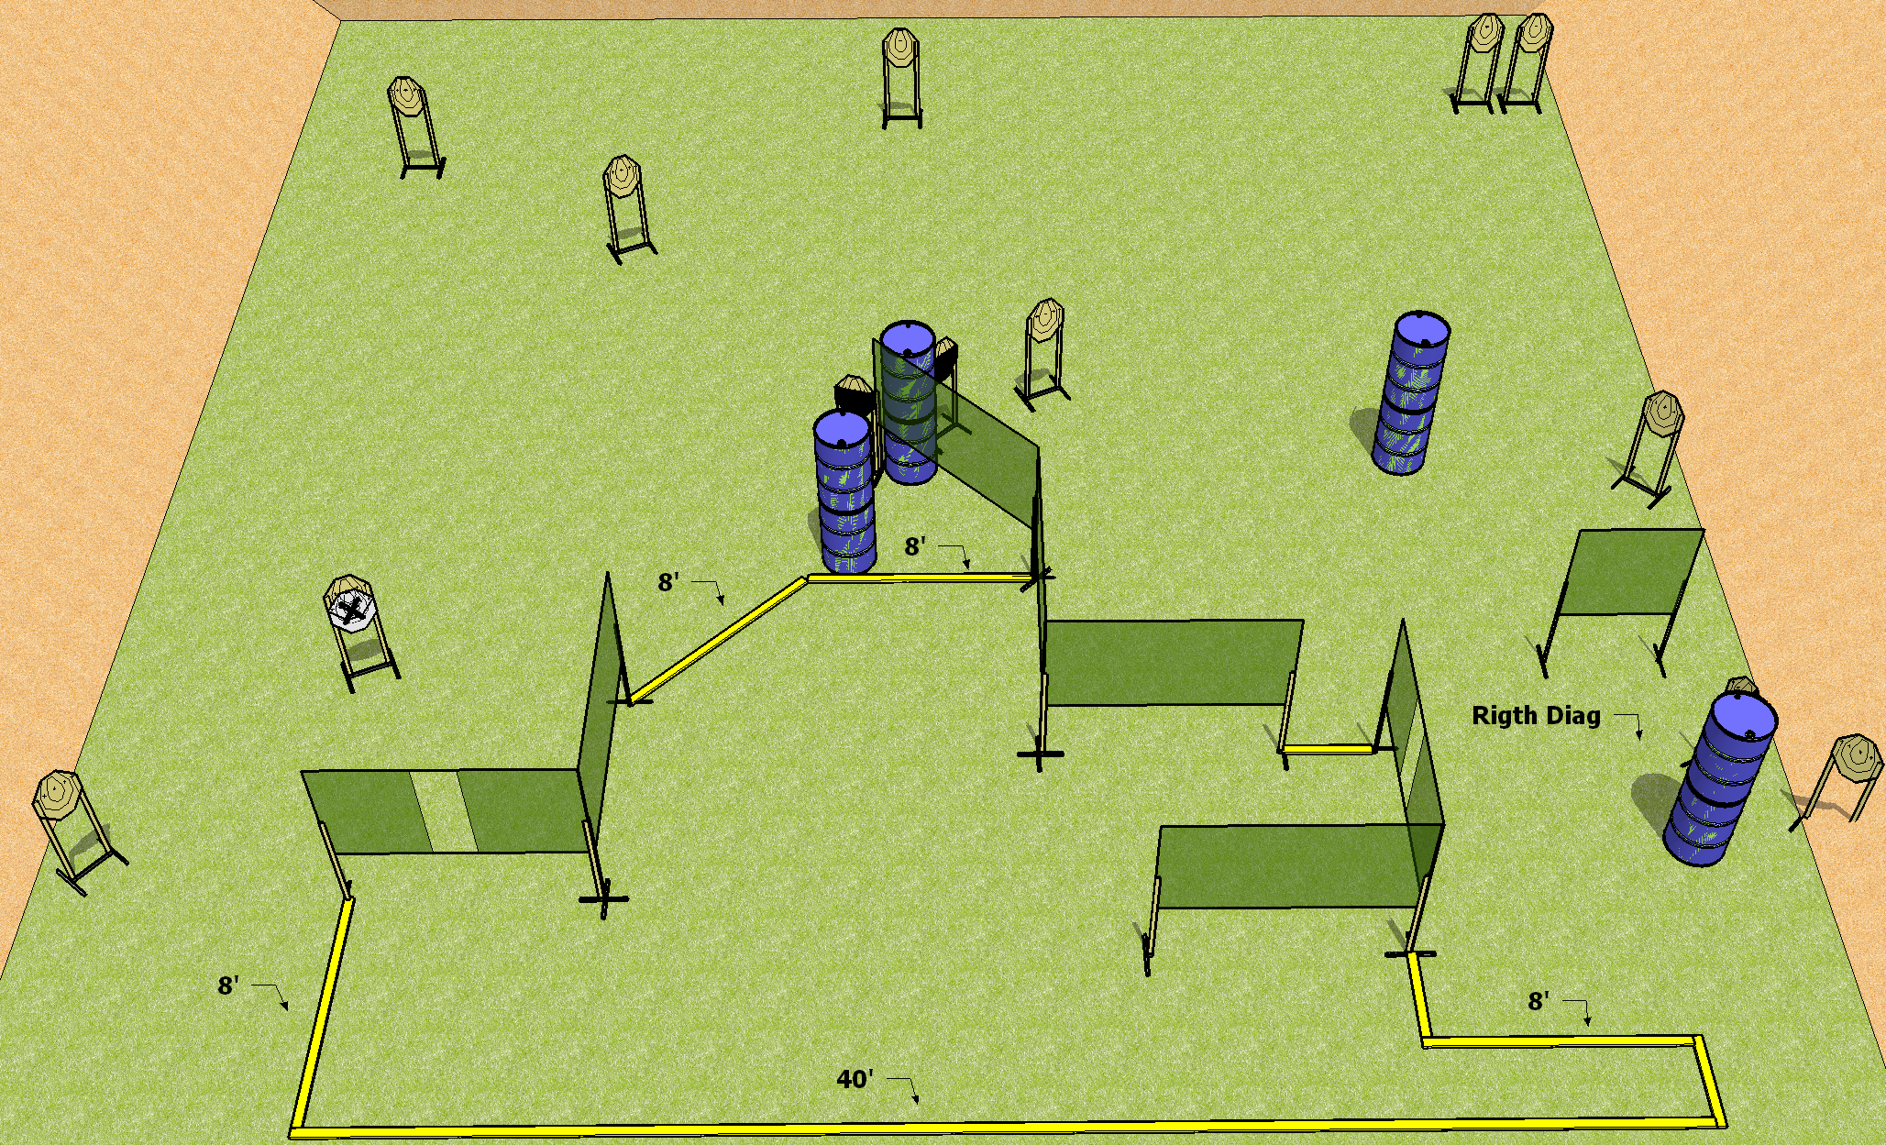
 | Dothan Practical Shooters – USPSA Match Be Careful What You Wish For Course Designer : Drew Coleman Bay: B3
Round Count 26 rounds 13 IPSC
Equipment List 13 wall feet 2 50%, 1 right diag 11 targets (10 + 1NS)

Slide 2
Be Careful What You Wish For
Written Stage Briefing
Scoring: Comstock Rounds: 26 rounds
Targets: 13 IPSC
Handgun start position: anywhere inside the shooting area, wrists below belt. Handgun is loaded and holstered.
PCC start position: anywhere inside the shooting area, stock on belt. Loaded carbine is held with both hands, safety on.
Stage Procedure: on the audible start signal, engage targets as they become available from within the shooting area.

